Slide 1



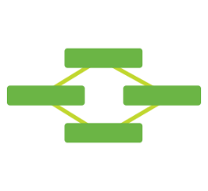
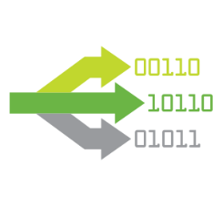

Qlik puede extraer datos de diversas maneras
Different data volumes and complexities are best met using different methods
On Demand App Generation
Different methods ensure an optimized experience for the user for every situation
Methods can be combined to meet different use cases
Methods vary in deployment complexity
Direct Discovery
Chaining
Data Volume
Size (rows)
Dimensions (columns)
Cardinality (uniqueness)
App Complexity
Computational complexity such as set analysis
Object density
In-Memory
Segmentation
Notes:
QlikView have developed a series of QlikStart templates, whilst we don’t profess to know the intricacies of your business by saying the templates will answer all of your business questions it gives a good head start both for IT by delivering the background database information of how tables within SAP interact and enables the business to quickly realize their own data in ways they may not have envisioned before.

Slide 2
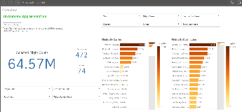
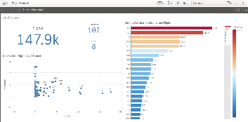
On Demand App Generation (ODAG)
1
App de Selección
Repositorio de Big data
Data Resumen
El App de Selección es usado para visualizar data resumen y seleccionar una porción de la información
El usuario solicita que se cree un App de Análisis
El App de Análisis es usado para analizar en detalle el resultado de la selección
El usuario puede repetir los pasos 1-3 cuantas veces sea necesario
Solicitud
2
2
Solicitud
3
App de Análisis
Notes:
At Qlik, we have a simple belief… The more people that use analytics, the more value organizations get from analytics.
Business Intelligence is optimized by harnessing the collective human intelligence across an organization.
Data is nothing more than a source
Technology is nothing more than an enabler
It’s people that harness information and make decisions

